Slide 1
My
Health Keeper
Team Aide
Siana Rizwan (180042105)
Farzana Tabassum (180042119)
Sabrina Islam (180042122)

Slide 2
Motivation
It wouldn’t have been bad if there was a single application that would help us to take care of our health by keeping a track of our medical records and our personal healthcare informations!
But unfortunately still there isn’t a single common platform that would manage and analyse our health informations for us and notify accordingly. Problems exist like -
Different applications for different healthcare services
Many applications doesn’t inform us regarding what to do if our health conditions is at risk
While visiting any doctor, we need to carry all our reports and prescriptions
Difficulties in evaluation of medical reports

Slide 3
My Health Keeper is a ONE STOP solution where users can store all sorts of health related information in ONE place

Slide 4
Features
Storing General Health Information
Regularly keep track of health related general information like -
Blood pressure
Pulse rate
Blood sugar level
Weight
And if any kind of abnormality is seen in any of those data then a warning notification will be sent to the user and suggestion for visiting the required type of doctors will be provided to the user

Slide 5
Features
2. Diet Plan
Log his/her consumed food items along with its amount and our application will calculate the calories intake.
Calculate his/her BMI. From the result, the application will suggest necessary steps for maintaining a healthy lifestyle for the user.
Monitor his/her weight.
Advantage:
It is especially useful for those who are planning to lose/gain weight.

Slide 6
Features
3. Storing Specialized Health Information
User can record any kind of abnormalities/diseases by -
Writing notes about his/her situation including its date
Uploading health related files and prescriptions etc.
Advantage:
Health related reports and other necessary information will be stored in a specific place
User need not to search or carry reports and prescriptions everywhere while visiting any doctor

Slide 7
Features
4. Report Analysis
User can upload two types of report -
MRI report of the brain
X-Ray report of the lungs
Our application will analyse the report and will give a list of probable diseases accordingly with a suggestion to visit the required doctor
Advantage:
Patient can get a basic idea regarding what’s wrong and where/to whom to go

Slide 8
Features
5. Disease Prediction
User can choose his/her evident symptoms then our application will showcase the possibility of probable diseases in percentage and so type of doctor will be suggested accordingly
Advantage:
Patient can get a basic idea regarding what’s wrong and where/to whom to go

Slide 9
Features
6. Medicine Reminder
User can list the names of medicines and set time and duration for them and a chart will be created accordingly. Before every medication a notification will be send as a reminder.
Advantage:
Now users cannot forget to take their medicines timely!
Track of medication can be maintained

Slide 10
Features
7. Menstrual Cycle Tracker
For female users, our application will have an additional feature where she can keep a track of the menstruation cycle by storing information like -
Starting of the cycle
Ending of the cycle
Duration of each cycle to come
Daily log
A reminder will be given to the user approximately 2 days before the starting of each cycle
Advantage:
Easiest way to keep track of women’s menstrual cycle
User can use it for future reference when required

Slide 11
Technologies
Frontend
Backend
Architectural Pattern
HTML
CSS
BOOTSTRAP
REACT
Django
SQLITE
Model-View-Controller (MVC)

Slide 12
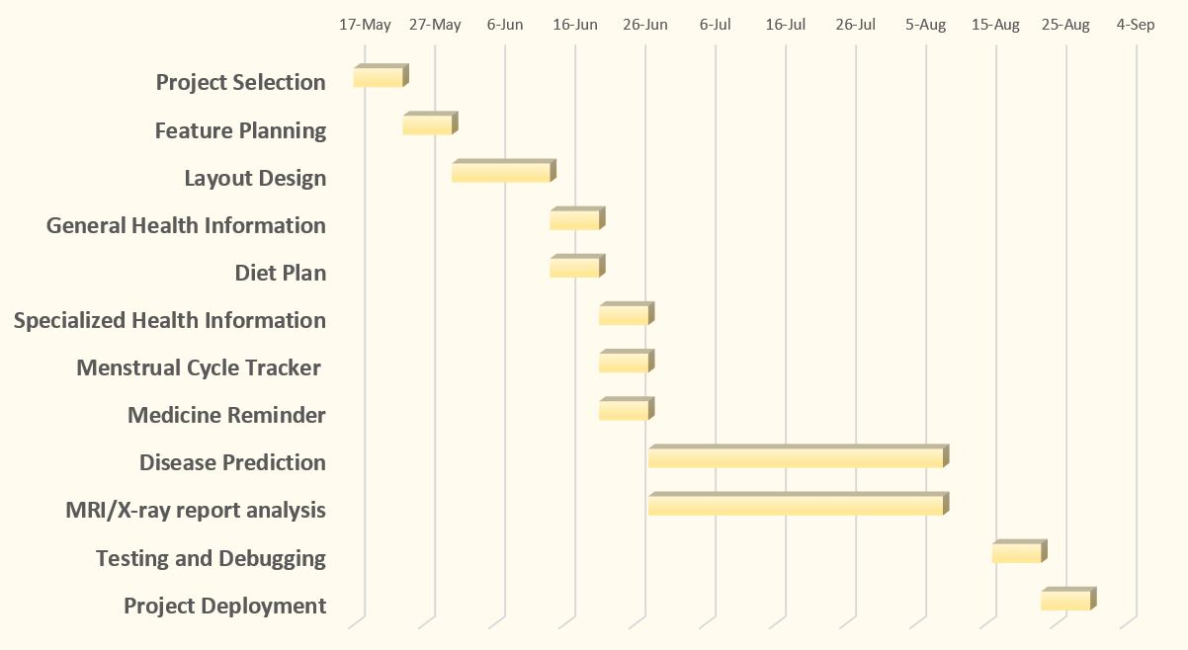
Timeline

Slide 13
Challenges
The frameworks are new for us so we need to invest more time in learning the implementation of the frameworks

Slide 14
Thank You!
The floor is open for Q/A

